Slide 1


Unmask
Masked Face.
PRESENTED BY
Harshit Timmanagoudar
DEPARTMENT OF COMPUTER SCIENCE, PES UNIVERISTY

Slide 2
DEPARTMENT OF COMPUTER SCIENCE, PES UNIVERSITY
1 | Problem Statement
2 | Literature Survey
3 | Methodology
4 | Experiment and Results
5 | Conclusion
6 | Future Work
Agenda

Slide 3

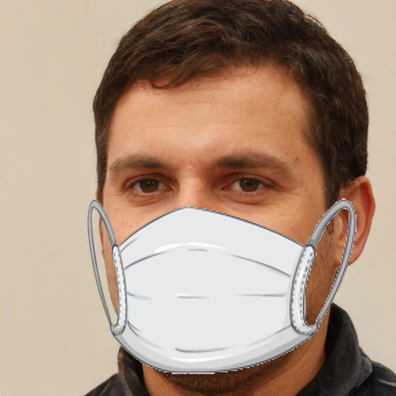
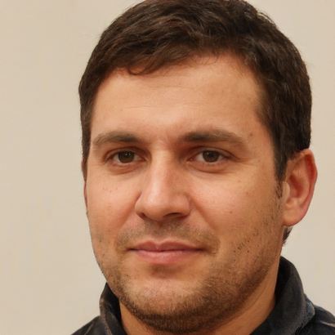
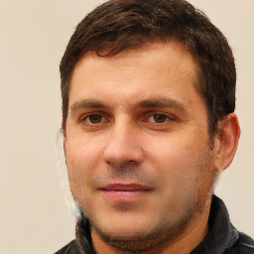
Problem Statement
The core objective of the study is to utilize an advanced method called Pix2Pix Generative Adversarial Networks to produce top-tier unmasked images. These images are intended to unveil the typically obscured facial traits and intricacies of individuals that are conventionally covered by masks.
Masked Input Image
Actual Unmasked Image
Synthesised Unmasked Image
DEPARTMENT OF COMPUTER SCIENCE, PES UNIVERSITY
BACK TO AGENDA

Slide 4
Literature Survey
The goal of the problem statement can be rephrased as removal of the obscuring mask object. Previous techniques not using machine learning "Region filling and object removal by exemplar-based image inpainting" and "Image melding: combining inconsistent images using patch-based synthesis" would take out the masked objects and fill the gaps with similar patches from different parts of the image. Another method described in "Scene completion using millions of photographs" matched patterns from a large database of scene images to replace the damaged region. However, these approaches were limited to removing small objects and didn't create satisfactory realistic results.
The concept of Generative Adversarial Networks (GANs), introduced by Ian J. Goodfellow et al., involves a competitive training process between the generator and discriminator models. The generator creates output data from random noise, while the discriminator's role is to differentiate between real and fake data. The feedback from the discriminator guides the generator to produce output that's challenging for the discriminator to distinguish as real or fake.
DEPARTMENT OF COMPUTER SCIENCE, PES UNIVERSITY
BACK TO AGENDA

Slide 5
On the other hand, Conditional GANs (cGANs), proposed by Mehdi Mirza and Simon Osindero, are influenced by specific information to learn the connection between related images. An example of a conditional GAN is Pix2Pix GAN, where the output image is dependent on an input image. This is unlike traditional GANs that generate random images from noise. These networks have been utilized in various applications such as generating cartoon images, creating shadows for virtual objects, predicting prognosis for breast cancer, determining optimal paths for autonomous robot systems, and many other fields of research.
The primary application of the Pix2Pix GAN revolves around Image-to-Image translation assignments, utilizing a generator model architecture known as "U-Net." This model has been harnessed for numerous tasks including data augmentation, colorization, transforming images from daylight to nighttime, and converting cityscape images from maps.
DEPARTMENT OF COMPUTER SCIENCE, PES UNIVERSITY
BACK TO AGENDA

Slide 6
Methodology
The Pix2Pix GAN is selected as the adopted approach for addressing the given problem statement for the following compelling reasons:
Conditional Input: A standout feature of the Pix2Pix GAN is its utilization of a conditional input, which in this case is the source image. This aspect is instrumental in guiding the image translation process, enabling the network to execute precise and targeted image-to-image translations that align with the specific task requirements.
Loss Functions: The Pix2Pix GAN incorporates a strategic combination of adversarial loss and supplementary losses. This synergy serves to incentivize the generated images to exhibit both realism and precision in their translations. The adversarial loss, in particular, impels the generated images to closely resemble authentic images within the intended target domain. Furthermore, the Pix2Pix GAN often integrates L1 or L2 distance loss, fostering pixel-level similarity between the generated images and the desired target images.
These intrinsic strengths equip the Pix2Pix GAN with the capability to effectively tackle image-to-image translation tasks, aligning seamlessly with the demands of the problem statement. In light of these factors, Pix2Pix GAN emerges as the ideal methodology to address the given challenge.
DEPARTMENT OF COMPUTER SCIENCE, PES UNIVERSITY
BACK TO AGENDA

Slide 7
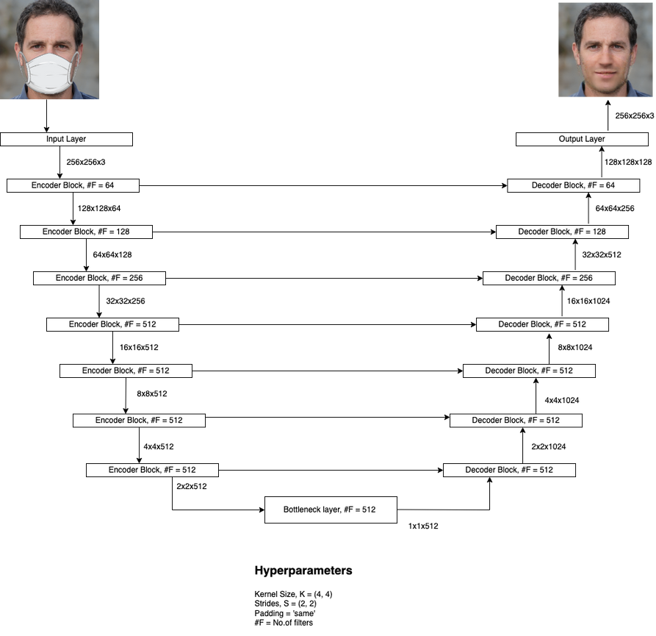
The Pix2Pix GAN consists of both a generator model and a discriminator model. These two components are trained in a reciprocal manner, with each model driving the other to improve its performance
The generator model has the role of creating unmasked images of individuals from their corresponding masked images, employing a U-Net architecture. Within this U-Net architecture, there are two main sections: the encoder and the decoder. The connections between the layers of these sections, known as skip connections, facilitate information flow. The encoder undertakes a continuous downsampling process, capturing and extracting lower-level details from the input image. Conversely, the decoder conducts upsampling to reconstruct the image using the extracted information, along with additional data conveyed through the skip connections.
Architecture of the Generator Model
DEPARTMENT OF COMPUTER SCIENCE, PES UNIVERSITY
BACK TO AGENDA

Slide 8
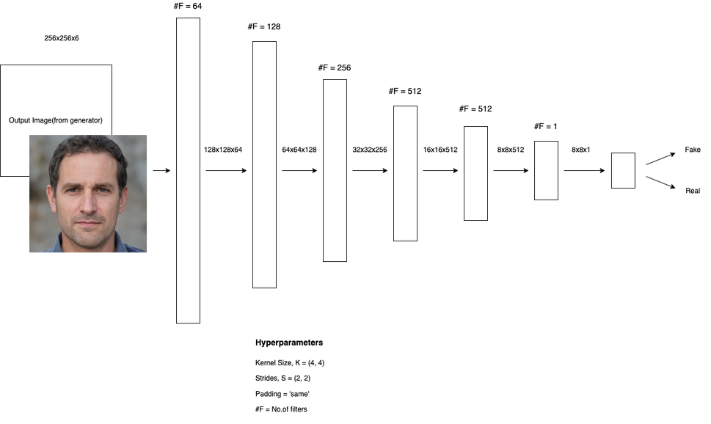
On the other hand, the discriminator model is tasked with distinguishing between authentic unmasked images and the synthesized counterparts generated by the generator. In this scenario, the discriminator model follows a PatchGAN architecture. This approach involves determining the authenticity of smaller patches within the image, ultimately calculating the probability of the image being genuine or fabricated. This probability serves as feedback to the generator model, prompting it to produce more lifelike unmasked images in an attempt to deceive the discriminator. This feedback loop is referred to as the Adversarial loss.
Alongside the previously mentioned Adversarial loss, the training of the Pix2Pix GAN also incorporates an additional loss termed the L1 loss. This per-pixel loss function is tailored to the specific task at hand, aiming to minimize the disparities between the synthesized unmasked images and the genuine ones at a fundamental level.
Architecture of the Discriminator Model
DEPARTMENT OF COMPUTER SCIENCE, PES UNIVERSITY
BACK TO AGENDA

Slide 9
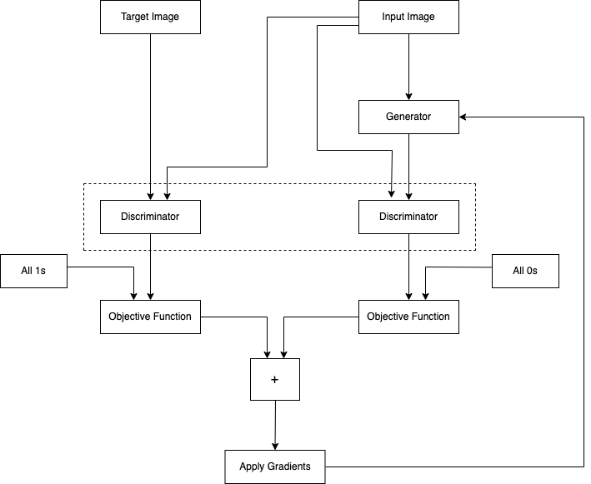
During training, the shared discriminator model evaluates both the generated unmasked image with the input masked image and the real unmasked image with the input masked image. This setup helps the discriminator distinguish between actual and synthesized outputs. The generator loss incorporates adversarial loss influenced by the discriminator and a task-specific loss like L1 loss, enabling the generation of more realistic images. Gradients from these losses guide variable optimization for both generator and discriminator. This process enhances the discriminator's ability to discern real from fake images and empowers the generator to produce more authentic visuals.
Training Process Flow of the Pix2Pix GAN
DEPARTMENT OF COMPUTER SCIENCE, PES UNIVERSITY
BACK TO AGENDA

Slide 10
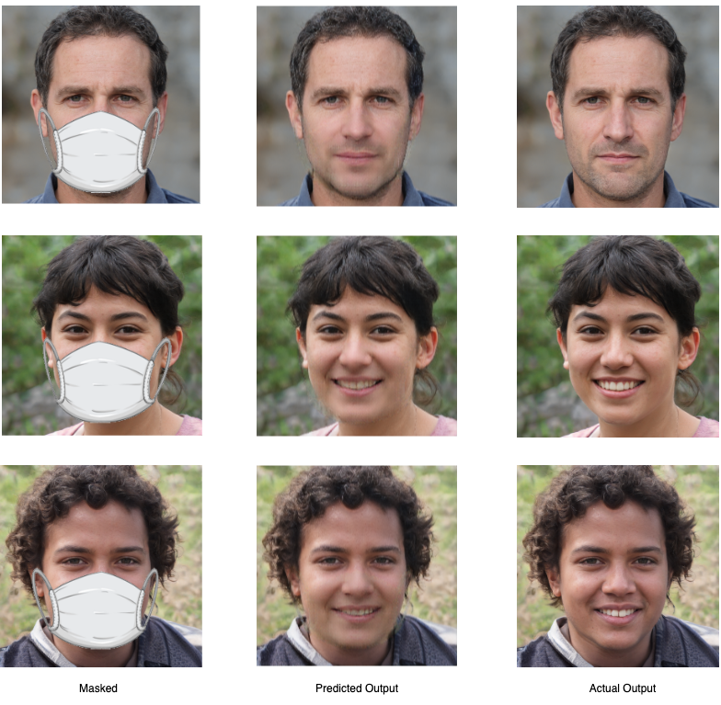
Experiment and Result
The unmasked images generated by the Pix2Pix GAN model indicate its capability to eliminate obscured mask objects and populate the vacant areas with appropriate low-level and high-level details. To substantiate our conclusion, we conducted a survey and gathered preference scores from a panel of individuals to assess the accuracy of our model's unmasked predictions. This approach was chosen because traditional metrics like per-pixel mean-squared error do not adequately capture the qualities of the final image.
This study involved 46 participants for evaluation. Our model achieved a score of 95.5 on the likability index, indicating that volunteers perceived its generated images as realistic. This subjective assessment provides a precise and accurate measure of synthesized image quality, capturing the human visual system's subjective experience, a dimension overlooked by standard metrics.
DEPARTMENT OF COMPUTER SCIENCE, PES UNIVERSITY
BACK TO AGENDA

Slide 11
Conclusion
Earlier, we introduced a Pix2Pix model designed to generate unmasked images from corresponding masked photographs using conditional adversarial networks and the U-net architecture. The outcomes depicted lead us to the observation that our model effectively generates unmasked images, and the subjective evaluation conducted with diverse volunteers assures us of its high likability. The model performs well for the masked objects within the dataset. However, despite these promising findings, our model encounters challenges in producing high-quality unmasked images when confronted with different types of masks in the input photos. Moving forward, our focus will be on enhancing the model's adaptability to accommodate masks of varying shapes and colors, rendering it more versatile.
DEPARTMENT OF COMPUTER SCIENCE, PES UNIVERSITY
BACK TO AGENDA

Slide 12
Thank you
Corresponding Author : Harshit Timmanagoudar
Contributing Author : Preethi P
Affiliation : Department of Computer Science, PES University

